Slide 1
Guided tour – Mr Jörg Schreiner (UMC Mainz)
Wednesday (June 3) – Mainz city tour
Cathedral - Rhine river view
https://www.istockphoto.com/de/foto/stadtbild-von-mainz-in-der-blauen-stunde-mit-mainzer-dom-gm1066191480-285113473?searchscope=image%2Cfilm
Roman amphitheater
https://www.istockphoto.com/de/foto/r%C3%B6mische-theater-in-mainz-gm178767291-25075979?searchscope=image%2Cfilm
Cathedral – city view
https://www.istockphoto.com/de/foto/mainzer-dom-luftbild-deutschland-gm2191654682-609967193?searchscope=image%2Cfilm
French fortress
https://www.istockphoto.com/de/foto/zitadelle-von-mainz-gm178164558-25027837?searchscope=image%2Cfilm
Frame houses
https://www.istockphoto.com/de/foto/mainz-germany-gm1266060539-371045809?searchscope=image%2Cfilm
St. Stephan‘s church
https://www.istockphoto.com/de/foto/inneneinrichtung-der-stiftskirche-st-stephan-in-mainz-gm1213547595-352735192?searchscope=image%2Cfilm
Old city defense – iron tower
https://www.istockphoto.com/de/foto/eiserner-turm-in-mainz-am-abend-gm1176015099-327714634?searchscope=image%2Cfilm
Ruins of Roman aqueduct
https://www.istockphoto.com/de/foto/roman-stones-mainz-district-bretzenheim-zahlbachtal-germany-gm1343694220-422350551?searchscope=image%2Cfilm
Explore the old town district of Mainz with the beautiful frame houses, the impressive cathedral, the French fortress, the historic cemetery as well as the ancient Roman amphitheater and aqueduct. The tour will start at the Hilton hotel at 14:00 and return is at 18:00. Please wear good shoes as the walking distance is roughly 8 km. No costs, only for beverage and food.

Slide 2
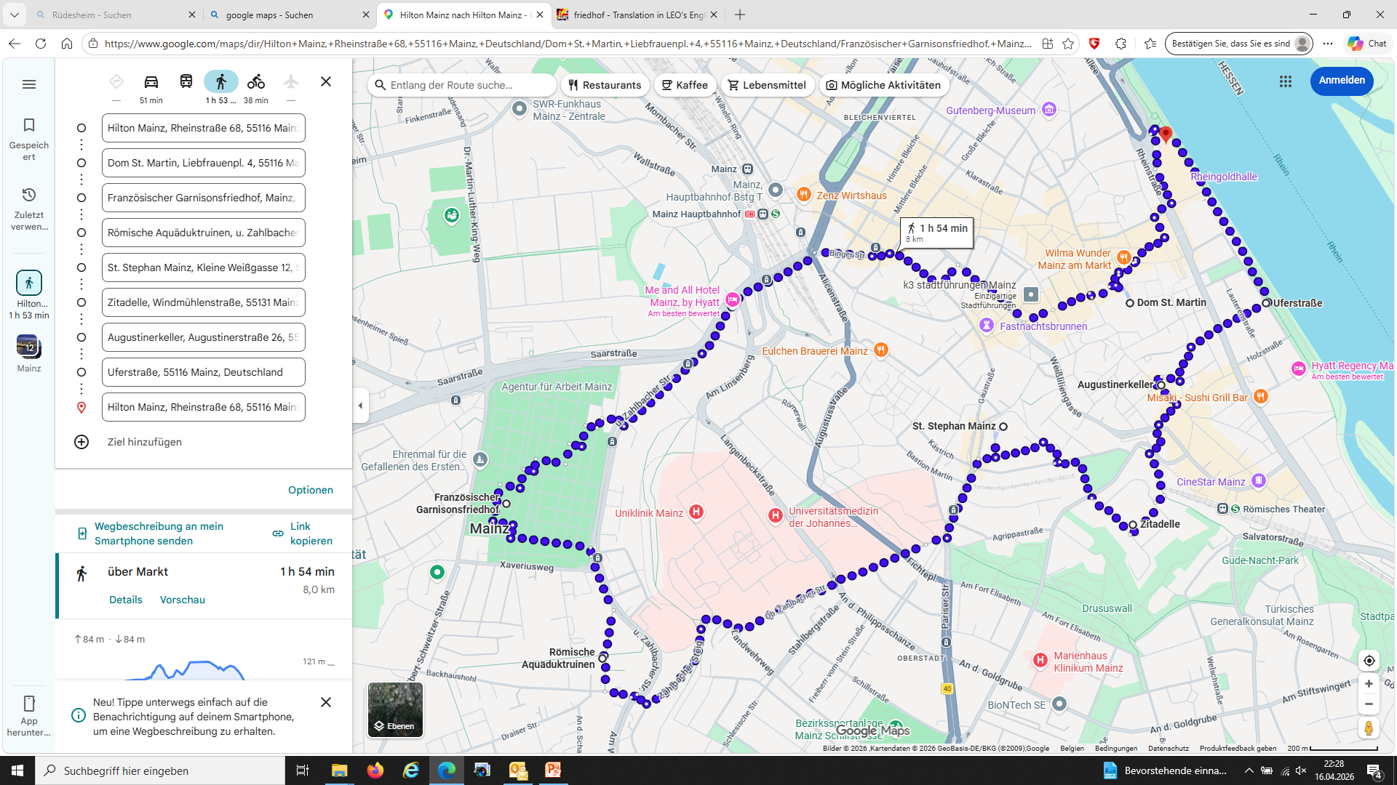
https://www.google.com/maps/dir/Hilton+Mainz,+Rheinstra%C3%9Fe+68,+55116+Mainz,+Deutschland/Dom+St.+Martin,+Liebfrauenpl.+4,+55116+Mainz,+Deutschland/Franz%C3%B6sischer+Garnisonsfriedhof,+Mainz,+Maguncia,+Deutschland/R%C3%B6mische+Aqu%C3%A4duktruinen,+u.+Zahlbacher+Str.,+55128+Mainz,+Deutschland/St.+Stephan+Mainz,+Kleine+Wei%C3%9Fgasse+12,+55116+Mainz,+Deutschland/Zitadelle,+Windm%C3%BChlenstra%C3%9Fe,+55131+Mainz,+Deutschland/Augustinerkeller,+Augustinerstra%C3%9Fe+26,+55116+Mainz,+Deutschland/Uferstra%C3%9Fe,+55116+Mainz,+Deutschland/Hilton+Mainz,+Rheinstra%C3%9Fe+68,+55116+Mainz,+Deutschland/@49.9961441,8.2559627,15.5z/data=!3m1!5s0x47bd9705272a0b37:0x8325fdb172708872!4m56!4m55!1m5!1m1!1s0x47bd9704c4367d97:0x32ca6b0f4e41ad35!2m2!1d8.2754631!2d50.0031085!1m5!1m1!1s0x47bd971b080f27c9:0x34915cd57f87184e!2m2!1d8.2739456!2d49.9988965!1m5!1m1!1s0x47bd970460ebe58b:0x681dcdb85afc78a6!2m2!1d8.2479435!2d49.9935174!1m5!1m1!1s0x47bd96c898c264b9:0x3f647ca926c48f4a!2m2!1d8.2519448!2d49.9893595!1m5!1m1!1s0x47bd971ec0704f29:0xb11a1fb6822fa62e!2m2!1d8.2686688!2d49.9955784!1m5!1m1!1s0x47bd971853a49e81:0xad81e3494bbc43f9!2m2!1d8.2740855!2d49.992948!1m5!1m1!1s0x47bd971a2116d141:0xede81de9f873ccec!2m2!1d8.2752447!2d49.9967003!1m5!1m1!1s0x47bd97105e3484bb:0x183fa18e1aec3753!2m2!1d8.2796345!2d49.9988909!1m5!1m1!1s0x47bd9704c4367d97:0x32ca6b0f4e41ad35!2m2!1d8.2754631!2d50.0031085!3e2?entry=ttu&g_ep=EgoyMDI2MDQxMy4wIKXMDSoASAFQAw%3D%3D

