Slide 1
Guided tour – Mr Jörg Schreiner (UMC Mainz)
Friday (June 5) - Rüdesheim boat trip
Rüdesheim – old alley with wine bars
https://www.istockphoto.com/de/foto/r%C3%BCdesheim-am-rhein-deutschland-gm2228779113-644543046?searchscope=image%2Cfilm
Rüdesheim – Rhine river view
https://www.istockphoto.com/de/foto/ruedesheim-am-rhein-town-in-germany-gm1751586586-543851464?searchscope=image%2Cfilm
Chair lift to the Niederwald monument https://www.istockphoto.com/de/foto/weinreben-und-seilbahn-mit-blick-richtung-r%C3%BCdesheim-gm2241479110-655983845?searchscope=image%2Cfilm
Niederwald monument https://www.istockphoto.com/de/foto/niederwalddenkmal-%C3%BCber-weing%C3%BCter-gm183065354-14445467?searchscope=image%2Cfilm
Scenic view from Niederwald monument https://www.istockphoto.com/de/foto/blick-vom-niederwalddenkmal-auf-rheingau-bingen-und-rheinhessen-gm1480143964-507921829?searchscope=image%2Cfilm
Rüdesheim is a historic village at the Rhine river with numerous inviting wine taverns. Taking the chair lift to the Niederwald monument will offer an awesome view on the beautiful Rhine valley. The tour will start in Mainz at 9:15, arrival in Rüdesheim at 11:00. Enjoy 5 h in Rüdesheim and surrounding. At 16:20 the boat will leave and arrive in Mainz at 18:40. For adults the prize is 31 EUR for the boat and 7,50 for the chair lift (one trip).

Slide 2
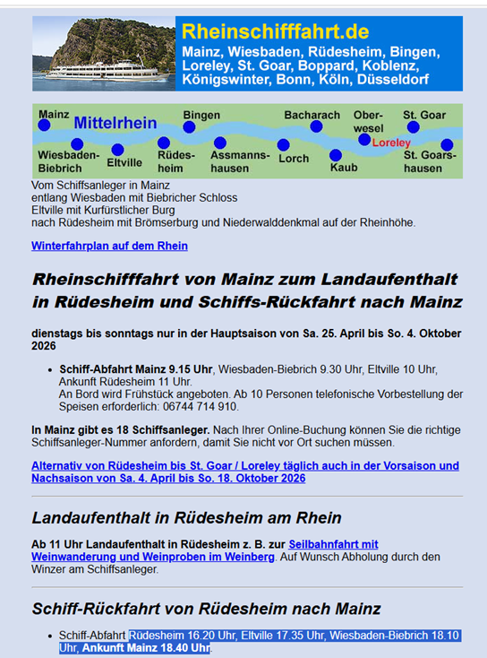
https://www.rheinschifffahrt.de/mainz/ruedesheim.html

